Slide 1
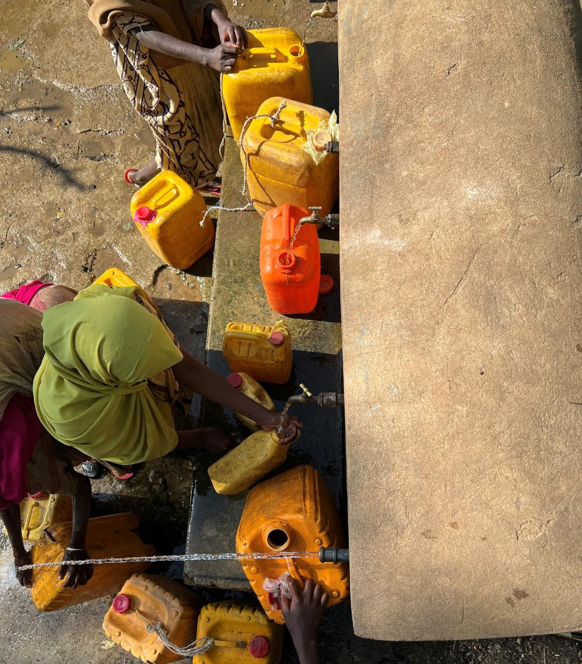
Lecture 1 - ENV 402
Sanitary Engineering for Development
Dr Jess MacArthur
Eawag-Sandec
Water collection at a tapped spring in Ethiopia
Source: MacArthur 2024

Slide 2
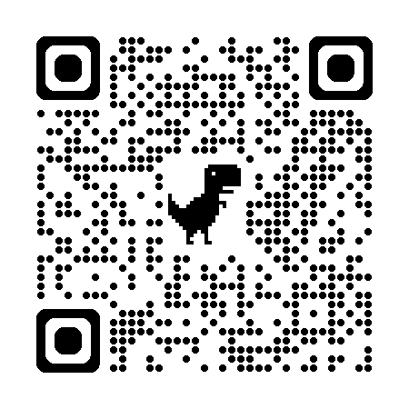
Early Birds
washdata.org

Slide 3
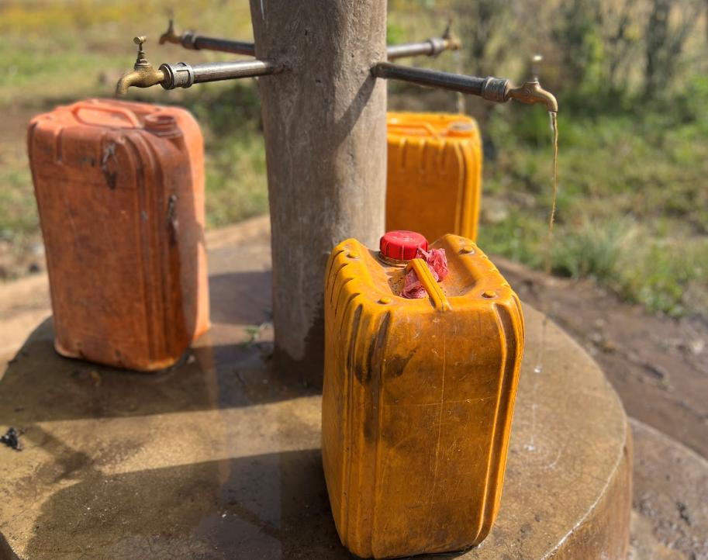
Today’s Objectives
Understand the expectations of the course, deliverables required and how to access material
Explain the relevance of WASH in different contexts such as humanitarian settings, dense urban areas, climate change and low-income countries
Describe the importance of the SDGs, and how WASH impacts the different SDGs.
Tapped spring in Ethiopia
Source: MacArthur 2024
3

Slide 4
Today’s Topics
Part 0 | Background | 15 minutes
Part I | Setting the Scene | 20 minutes
Part II | WASH & Public Health | 20 minutes
Stretch |  | 5 minutes
Part III | WASH & the SDGs | 20 minutes
Part IV | Semester Group Work | 20 minutes
Part 0 | Background | 10:20 – 10:35 | 15 minutes
Part I | Setting the Scene | 10:35 – 10:55 | 20 minutes
Part II | WASH & Public Health | 10:55 – 10:35 | 20 minutes
Stretch |  | 11:15 – 11:20 | 5 minutes
Part III | WASH & the SDGs | 11:20 – 11:40 | 20 minutes
Part IV | Semester Group Work | 11:40 – 12:00 | 20 minutes

Slide 5
Course Overview
Lectures: Thursdays at 10:15
Group work: ~1 hour/week
No. | Date | Topic | Lecturer
1 | 11 Sept | Intro to ENV 402, overview, SDGs, public health | J. MacArthur
2 | 18 Sept | Water treatment and safe storage | L. Fache
3 | 25 Sept | Water supply from source to consumer | M. Boller
4 | 2 Oct | Municipal solid waste management | D. Tosi
5 | 9 Oct | Sanitation systems and technologies Part 1 | A. Narayan / P. Reymond
6 | 16 Oct | Sanitation systems and technologies Part 2 | K. Coppens
 | 23 Oct | Semester break
7 | 30 Oct | Guest lecture: Innovations & WASH | Michael Kropac – Co-Director Cewas
 | 6 Nov | Group work
8 | 13 Nov | WaSH in humanitarian settings | K. Gallandat
9 | 20 Nov | Becoming a WASH and Solid Waste Management Researcher | F. Suter / Velasquez L. / Peguero D.
10 | 27 Nov | Environmental sanitation planning | A. Narayan
11 | 4 Dec | Innovative Sanitation Planning in practice | A. Narayan
 | 11 Dec | Group work Q+A (on-line: 10:15 – 11:00) | C. Lüthi
 | 18 Dec | Mock exam, career prospects | C. Lüthi
 | Winter Break
 | 15 Jan | Final written exam | C. Lüthi

Slide 6
Course Lecturers
C. Lüthi
(Course Coordinator)
J. MacArthur
L. Fache
M. Boller
D. Tosi
A. Narayan
K. Coppens
K. Gallandat
F. Suter
P. Reymond
L. Velasquez
D. Peguero
sandec.ch

Slide 7
Course Objectives
  Overall: Understand and reflect on key issues of global WASH targets, trends and developments
Water
[Lectures: 2,3]
Solid Waste
[Lecture: 4]
Sanitation
[Lectures: 5,6]
Cross-cutting
[Lectures 7-11]
Group work
  Become familiar with water treatment options and promotion & marketing challenges
  Understand key tools and methods for assessing human health aspects of WASH
  Understand key challenges for planning/implementing basic services in rapidly growing urban areas
  Understand the challenges and opportunities in municipal solid waste management
  Understand the sanitation system chain and be familiar with typical solutions in each functional group
  Understand the issues of faecal sludge management and be familiar with treatment solutions
  Learn about recent innovations in WASH
  Explore WASH in humanitarian settings
  Reflect on becoming a WASH and solid waste planning researcher
  Explore innovative and environmental sanitation planning
  Apply course knowledge: Analyze a case study assignment and provide realistic solutions for drinking water, sanitation and solid waste management

Slide 8
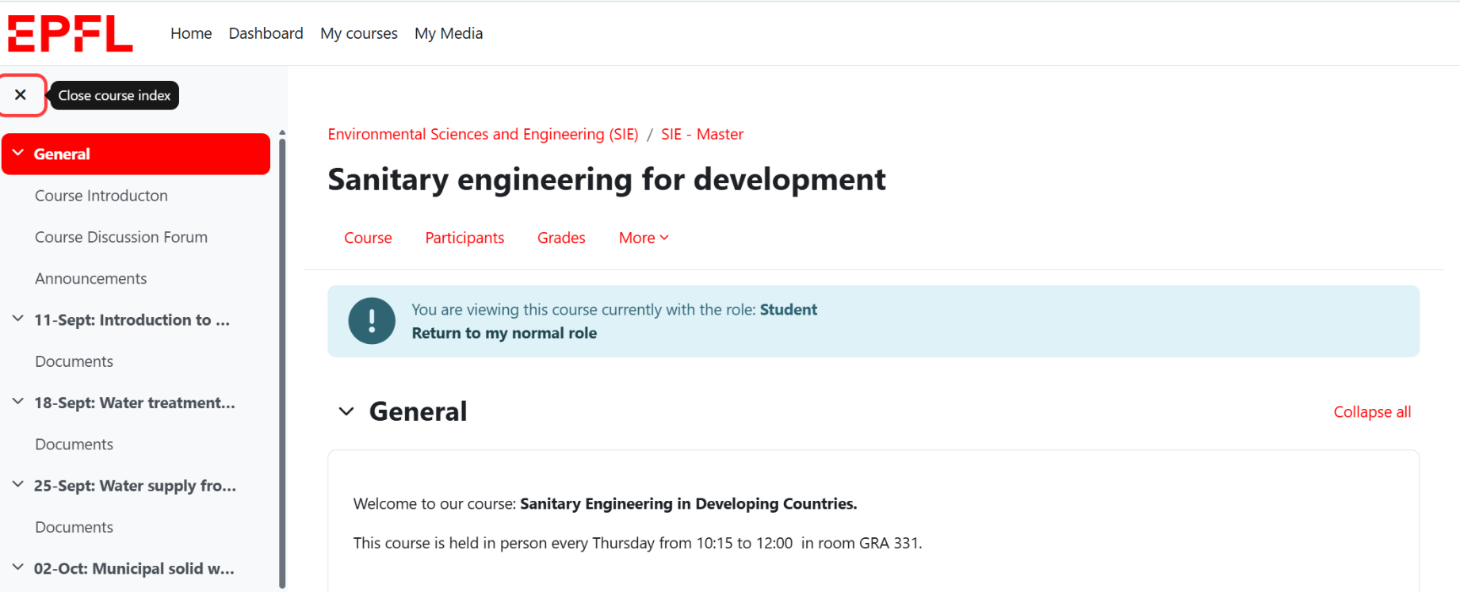
Course Moodle
https://go.epfl.ch/ENV-402

Slide 9
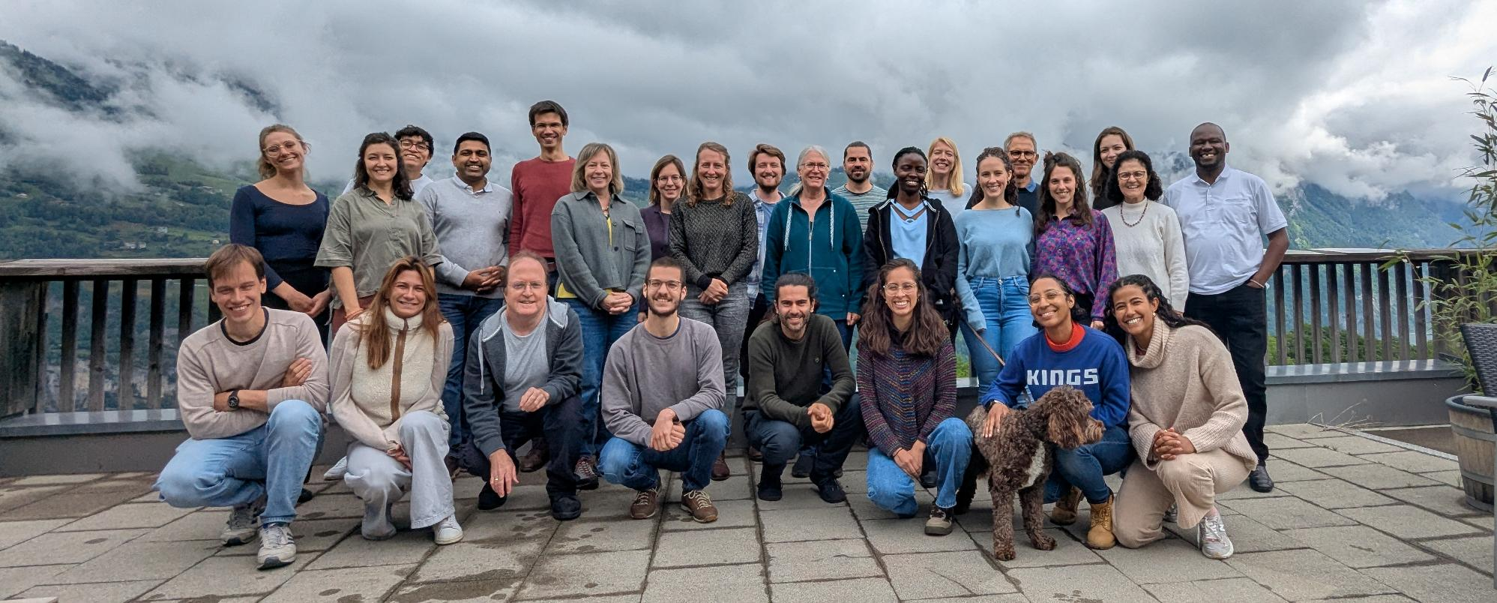
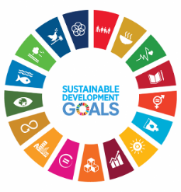
Introducing Sandec
The Sandec Team (retreat May 2025)

Slide 10
Sandec Groups
Sanitation, Water and Solid Waste for Development
Municipal Solid Waste Management
Strategic Environmental Sanitation Planning
Management of Excreta, Wastewater and Sludge
Water Safety Management
Water Supply and Treatment
Organizations and Climate
Public Health, Infrastructure and Climate
new!
new!

Slide 11
Paired Discussion (2 minutes)
What is your motivation for being in this course?

Slide 12
About me – Dr Jess MacArthur
Academic Background
BSc in Chemical Engineering – University of Calgary
MSc in Water Science, Policy and Management – University of Oxford
Phd in Sustainable Futures – University of Technology Sydney
Professional Background
iDE, Bangladesh – WASH Advisor, WASH Director
Save the Children, Global – Research and Learning Advisor
Institute for Sustainable Futures – Adjunct Research Fellow
Independent Consulting (HKI, IRC-WASH, WaterAid, Splash…)
Sandec-Eawag since May 2025 – Knowledge Broker
Lived: Australia, Bangladesh, Canada, Indonesia, Switzerland, Thailand, Turkey, the United Kingdom, and the United States.
Extensive professional experience: Bangladesh, Cambodia, Ethiopia, Nepal, Ghana, Togo, Zambia, and Zimbabwe.
Additional support: Bhutan, Burkina Faso, Democratic Republic of Congo (DRC), Laos PDR, Madagascar, Mali, Mozambique, Niger, Timor-Leste, Uganda, Vanuatu, and Vietnam.
https://sites.google.com/view/jess-macarthur

Slide 13
Part I
Setting the Scene

Slide 14
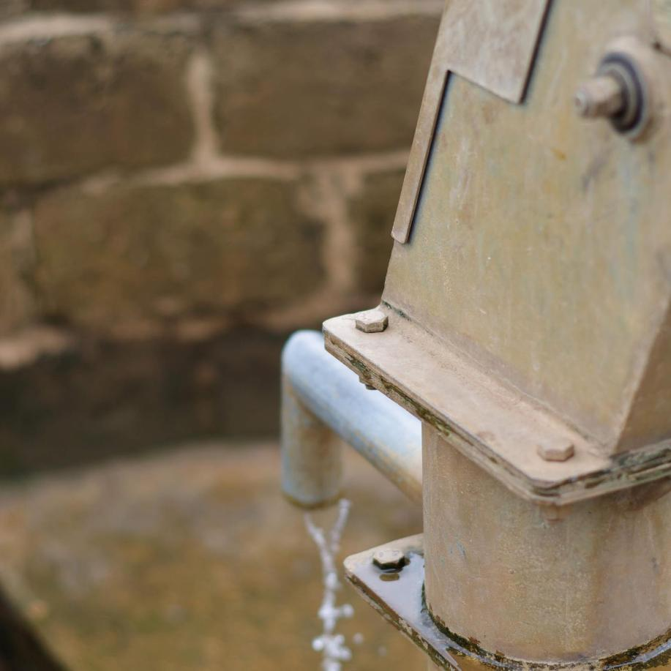
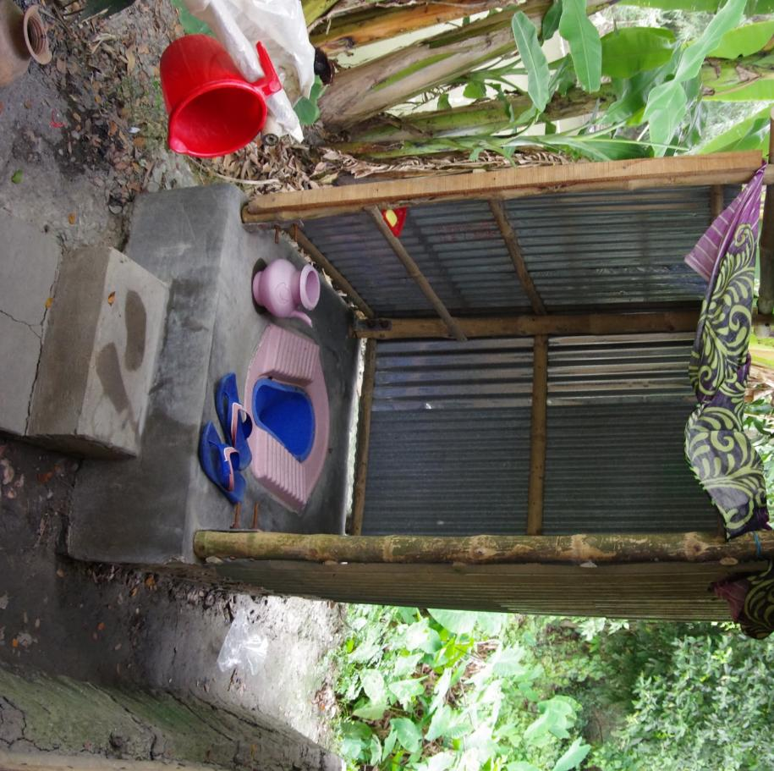
≈≈
Photo source for these stories: Jess MacArthur, unless otherwise noted
Notes:
I’d like to share two stories from the WASH sector.

Slide 15

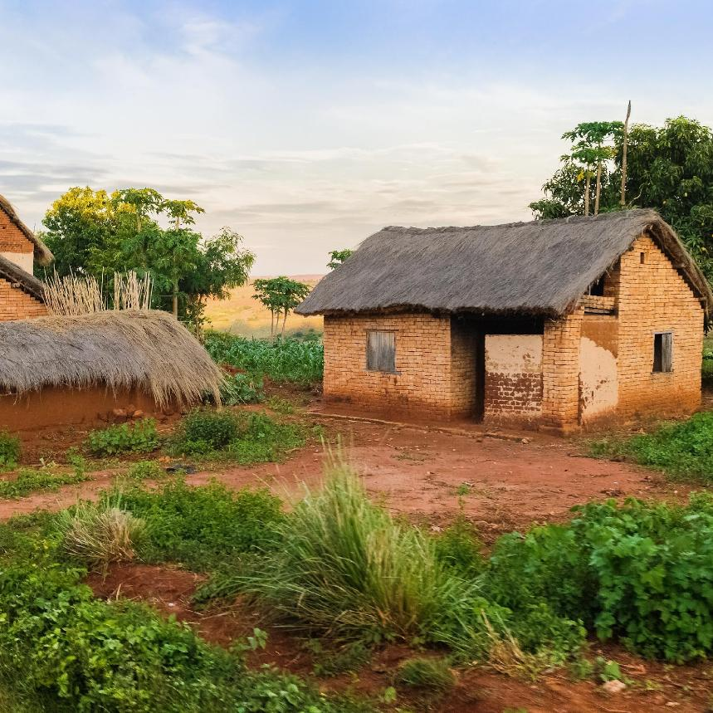
Image: Adobe Stock
Ethnographic Study: Van Houweling 2015
Notes:
In our first story in Mozambique, handpumps were installed in communities
where people collected water from rivers and shallow wells.
Abstract from Houweling 2015
In many parts of rural Africa, women and children spend a lot of time collecting water. In the development literature, the water collection task is portrayed as oppressive, arduous, and disliked by women. Eliminating this activity from women’s lives is believed to empower them, yet there has been little research investigating what actually happens at the water source or how women themselves perceive the time spent there. This research is based on one year of ethnographic fieldwork in five rural communities in the northern province of Nampula, Mozambique.
Over this year, handpumps were constructed in communities where people previously collected water from distant shallow wells and rivers. This article compares the social interactions and activities between the customary water sites and the handpump through the lens of gendered space.
The customary water sites are controlled by women and highly valued for their social attributes.
While clean water is more accessible at the handpumps, men often regulate access to the technology and social activities are limited.
This article contributes to feminist geography and political ecology by showing how differences in the materiality of water spaces interact with local norms to shape social interactions and gendered subjectivities, and how, in turn, men and women contribute to the production and meaning of these spaces. I argue that the handpumps open up new spaces for men and women to negotiate gender roles and (re)define their associations with modernity and development.

Slide 16
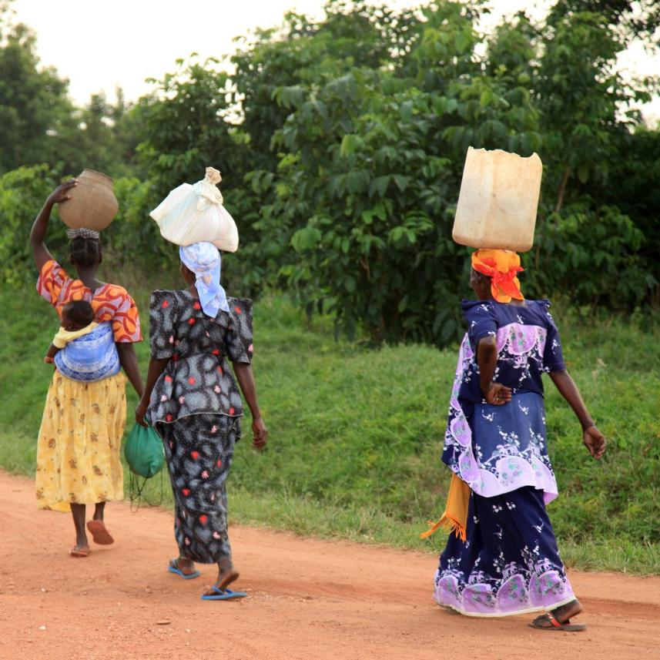
Image: Adobe Stock
Notes:
The existing wells and river points were traditionally used and managed by women, and were important spaces for women’s social interactions.

Slide 17
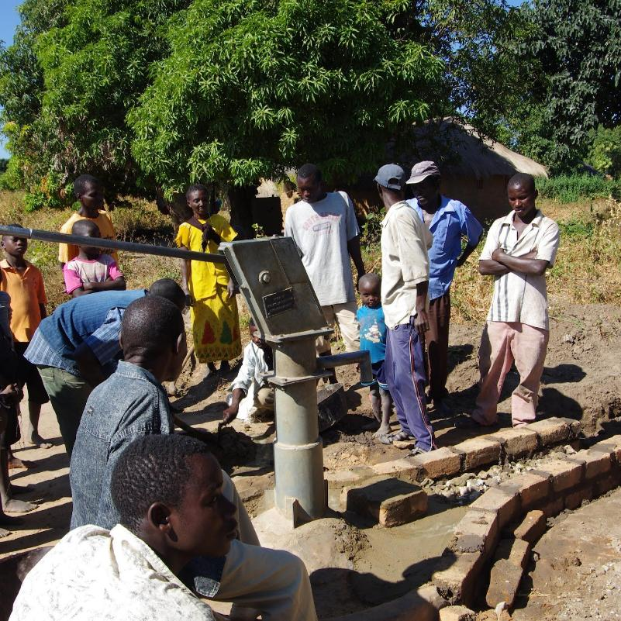
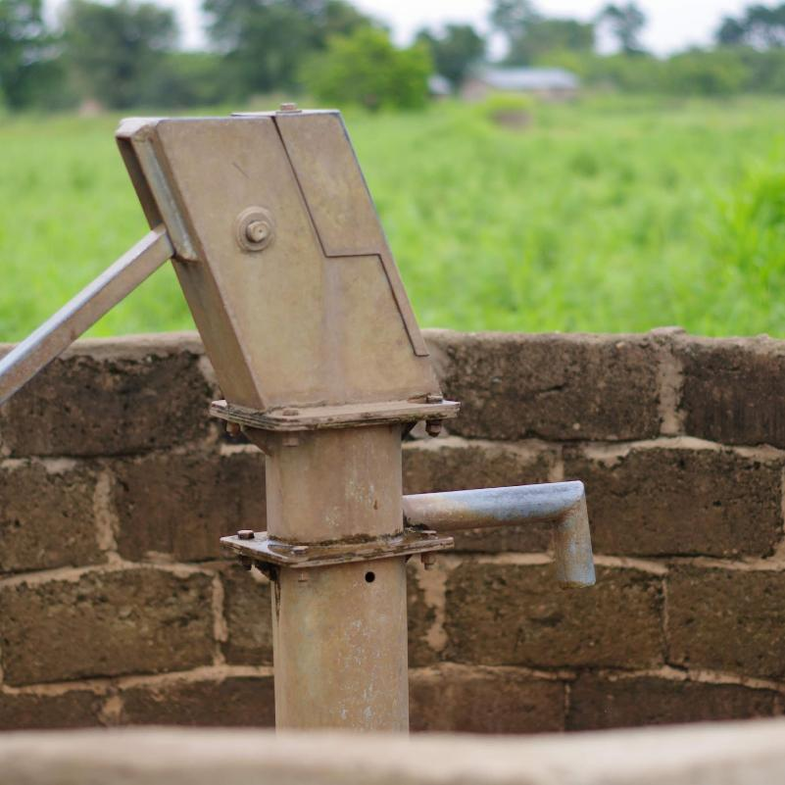
Notes:
However, when the new handpumps were installed, they were often controlled by men, and women’s social interactions during water collection became limited. In many parts of rural Africa, women and children spend a lot of time collecting water. In the development literature, the water collection task is portrayed as oppressive, arduous, and disliked by women. Eliminating this activity from women’s lives is believed to empower them, yet there has been little research investigating what actually happens at the water source or how women themselves perceive the time spent there. This research is based on one year of ethnographic fieldwork in five rural communities in the northern province of Nampula, Mozambique.
Over this year, handpumps were constructed in communities where people previously collected water from distant shallow wells and rivers. This article compares the social interactions and activities between the customary water sites and the handpump through the lens of gendered space.
The customary water sites are controlled by women and highly valued for their social attributes.
While clean water is more accessible at the handpumps, men often regulate access to the technology and social activities are limited.
This article contributes to feminist geography and political ecology by showing how differences in the materiality of water spaces interact with local norms to shape social interactions and gendered subjectivities, and how, in turn, men and women contribute to the production and meaning of these spaces. I argue that the handpumps open up new spaces for men and women to negotiate gender roles and (re)define their associations with modernity and development.

Slide 18
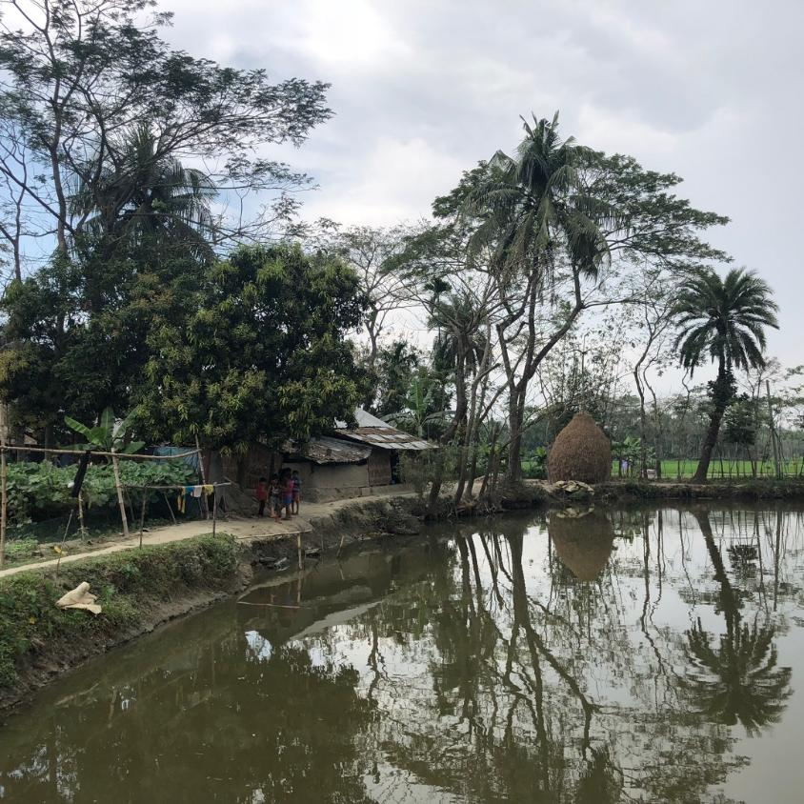
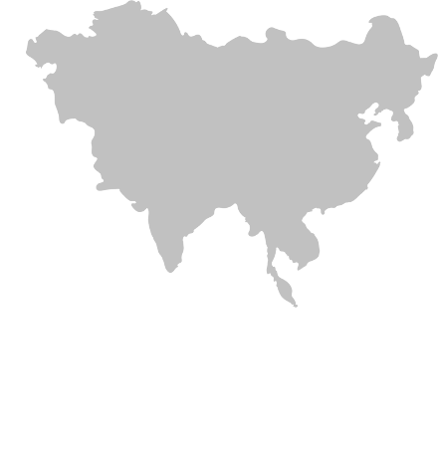
Notes:
Our second story is from Bangladesh. Here a sanitation program aimed to
increase access to improved latrines.

Slide 19
Notes:
Yet, on a monitoring visit to the new shiny latrines, the team noticed that
the latrines were installed in the front courtyards of houses.

Slide 20
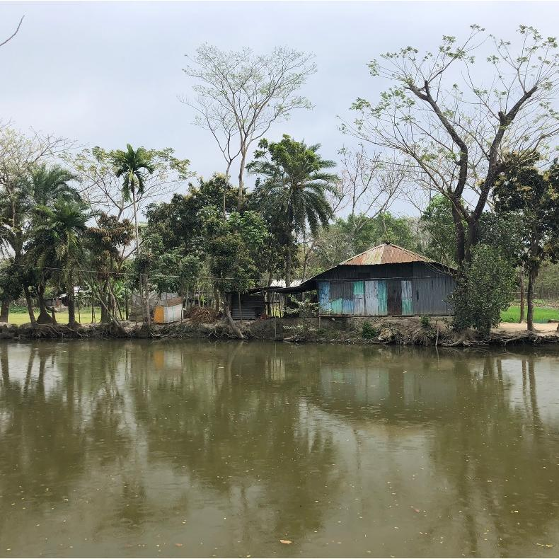
Notes:
In some conservative areas of Bangladesh, women hold to a cultural practice that means they prefer to avoid having men see them entering the toilet.

Slide 21
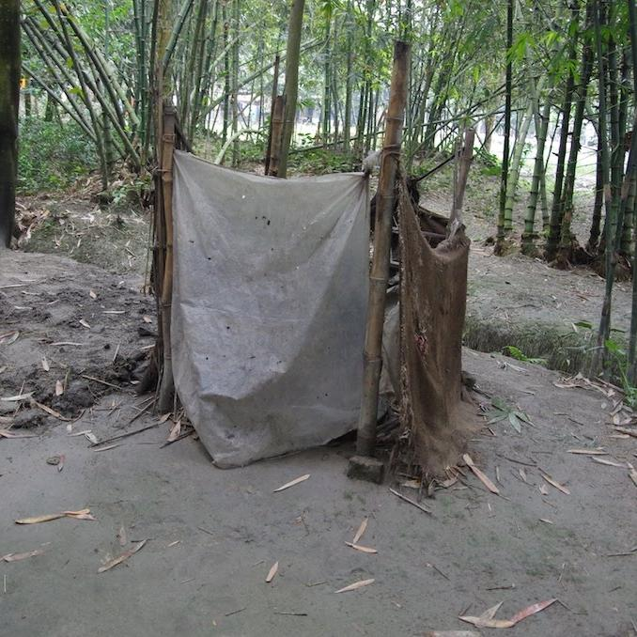

Notes:
This resulted in men being able to use the new and improved latrines,
while women and girls had to continue using the unsafe latrines behind the house.

Slide 22
Key Terms
Water
Sanitation
Solid Waste
Storage
Hygiene
Handwashing
Menstrual
Bathing
Toothbrushing
Supply
Treatment
Facilities/Collection
Treatment
Disposal/Use
Transport
Collection/Transport
Treatment/Recycling
Disposal/Use
WatSan – Water and Sanitation (outdated, less common)
WASH – Water, Sanitation and Hygiene
For this course (and at Sandec) we also include Solid Waste Management

Slide 23
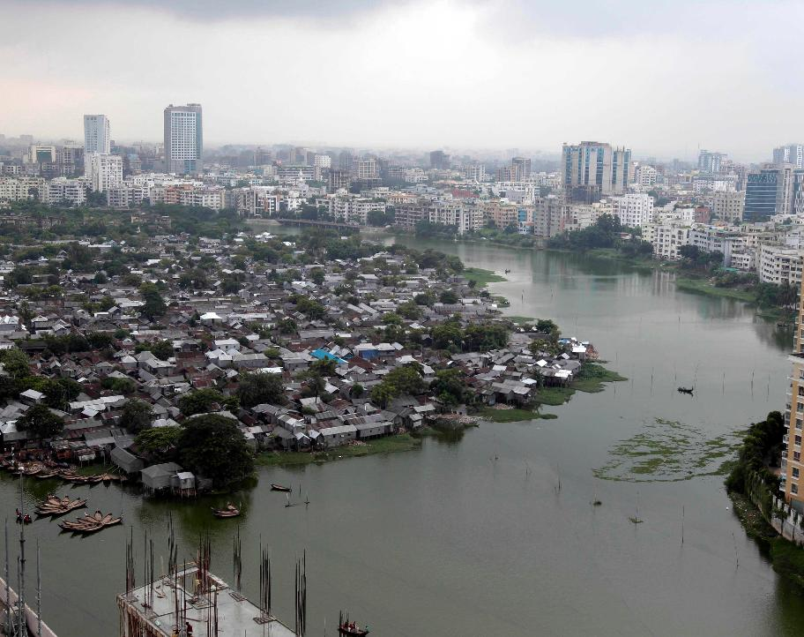
Rapid Urbanisation
In 1950, 30% of the population lived in urban areas; today 56% (2024), with a projected 68% in 2050.
Rapid urbanisation means that households do not connect to the municipal system because they:
  …live outside the area served by the formal system
  …live in informal settlements and are denied connections to public services
  …are unable to pay service charges
  …are unwilling to pay because they already have some form of service
A view of Korail slum in Dhaka, Bangladesh Source: AM Ahad/AP
Notes:
In 1950 only 30% of the worldwide population was urban; it is now 55% (2018) and growing, projected to be at 68% in 2050.
This rapid growth of cities means that the increase of people arriving in cities is higher than the capacities of cities to absorb them in terms of providing shelter and adequate access to basic services such as safe drinking water and adequate sanitation. This leads to people living in devastating conditions and leads to the building of informal settlements, also called slums.
[click]
Rapid urbanisation also means that households (HHs) do not connect to the municipal system because they
[click]
…live outside the area served by the formal system;
[click]
…live in illegal settlements and are denied connections to public services;
[click]
…are unable to pay service charges; or
[click]
…are unwilling to pay because they already have some form of sanitation.

Slide 24
Context: Low- and middle-income urban areas
Low-income (informal) settlements
Densely populated
High poverty levels
Lack of (adequate) waste collection services
Lack of water, wastewater or solid waste treatment plants
Discharging wastewater and solid waste into environment
City of Mumbai
Source: Johnny Miller
Notes:
These are the contexts where we as Sandec groups are mostly active.
We predominately work in urban development contexts, which usually are in urban areas and either formal or informal low-income settlements. Often, these contexts are characterised by high poverty levels and densely populated areas.
This means, there is hardly any space to build a sanitation system. Because poverty levels are high, people often cannot afford – or are not willing to pay – for sanitation services.
How do you establish adequate sanitation is such contexts?

Slide 25
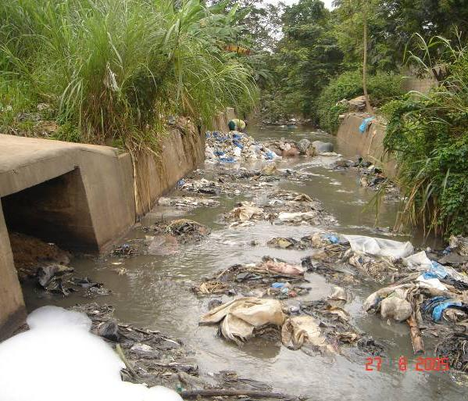
WASH Challenges: Low- and middle-income urban areas
Solid waste clogging storm drains
Source: Doulaye Kone (Eawag)
Wastewater dumping into landfill
Source: Linda Strande (Eawag)
Notes:
These are the contexts where we as Sandec and our Strategic Environmental Sanitation Planning group are mostly active.
We work in urban development contexts, which usually are in urban areas and either formal or informal low-income settlements. Often, these contexts are characterised by high poverty levels and densely populated areas.
This means, there is hardly any space to build a sanitation system. Because poverty levels are high, people often cannot afford – or are not willing to pay – for sanitation services.
How do you establish adequate sanitation is such contexts?

Slide 26
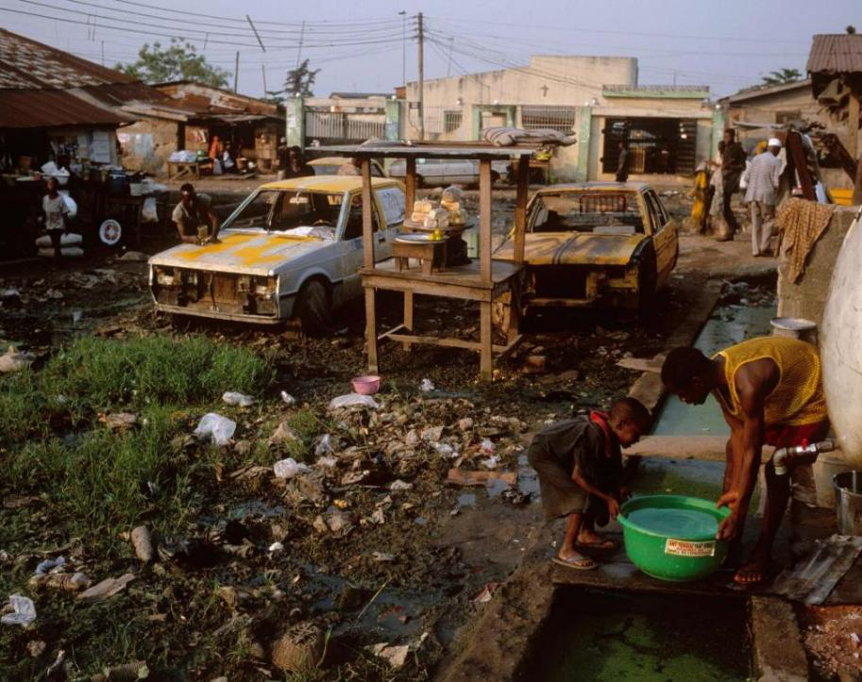
Informal Settlements: Characteristics
Today ~1 billion slum dwellers
Substandard housing
No or insufficient access to services (water, sanitation, waste mgmt.)
Lack of tenure security
Many slum dwellers rent and do not own their structures
Informal settlement in sub-Saharan Africa
Source: C. Lüthi (Eawag)

Slide 27
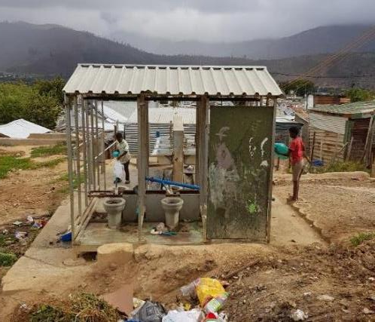
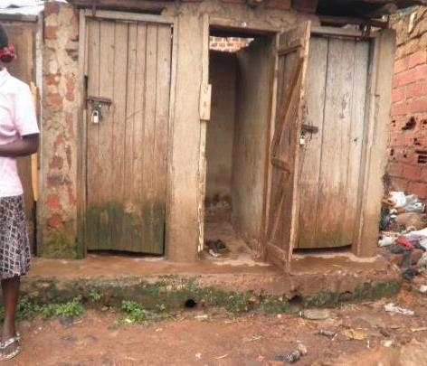
Informal Settlements: Sanitation Facilities
Shared sanitation facilities
Source: U-Act
Poorly maintained shared latrines in the Langrug informal settlement, Franschhoe Source: Kevin Winter

Slide 28
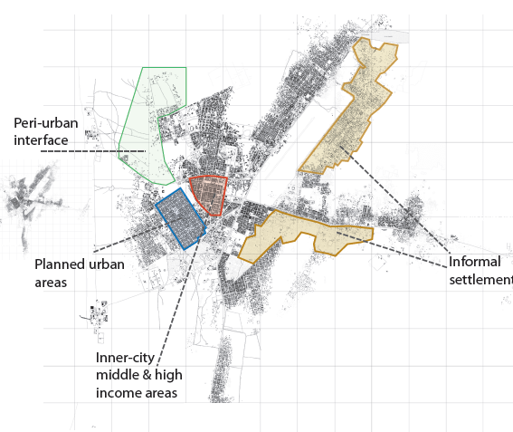
Importance: Sanitary engineering & contextual planning
Understand the context, design from evidence
Cities and people are complex & dynamic
WASH services are context-dependent and must be socially accepted
There is a need for a range of service models, no one-size fits all solutions!
Range of urban contexts
Source: Reymond et al. 2016

Slide 29
Considerations: Sanitary engineering & contextual planning
Physical context | Socio-cultural context | Political, legal & institutional context | Financial & economic context | Technical capacity context
Climate (temperature, rainfall…) Soil (rock, sand...) Water availability Groundwater Population density | Defecating posture (sitting/squatting) Anal cleansing material used (washers/wipers) Cultural and gender aspects (privacy, taboos on handling waste…) | Regulations and standards Organizational setup and responsibilities Political will and support Bureaucracy | Affordable technology Willingness to pay for appropriate service level Availability of credits and loans | Availability of Local skills Human power Materials & tools Financial resources (Needed for sustainable operation and maintenance)

Slide 30
Part II
WASH & Public Health

Slide 31
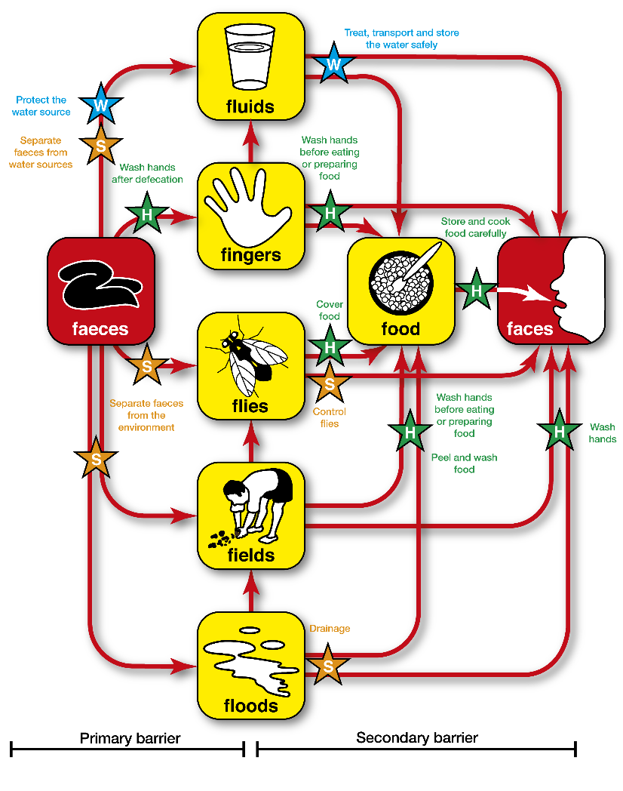
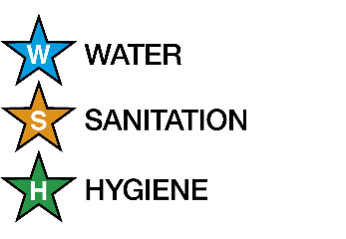
The «F-Diagram»
All key words are "F"
From Faeces to Faces
  Shows pathogen movement from faeces of a sick person to a potential new host
Different measures to prevent transmission
Source: Rod Shaw, WEDC

Slide 32
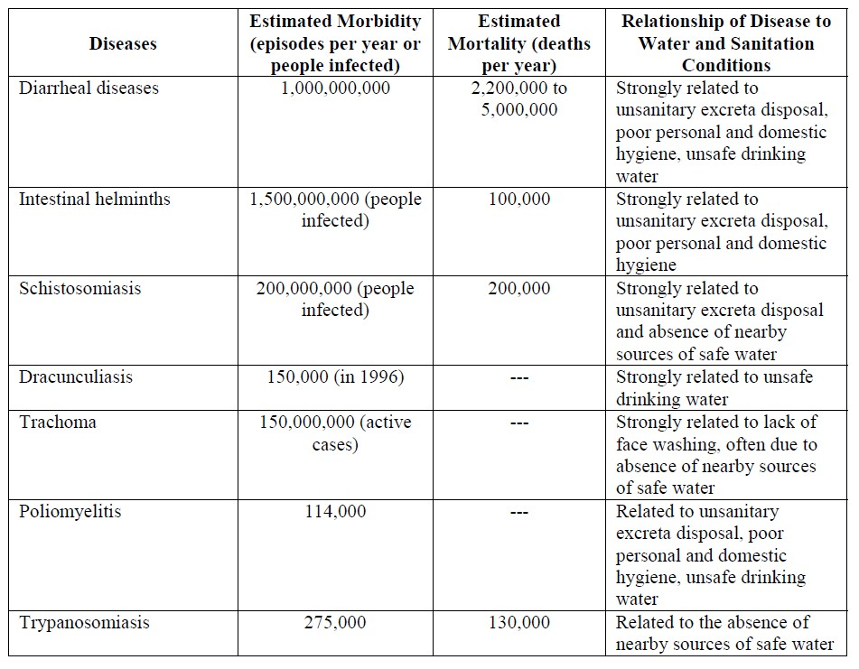
WASH Health Impacts
Per year:
2.2 – 5 million deaths due to diarrhea
1.5 billion intestinal infections
Morbidity refers to illness or disease
Mortality refers to death
Source: Gleick 2012, The Pacific Institute

Slide 33
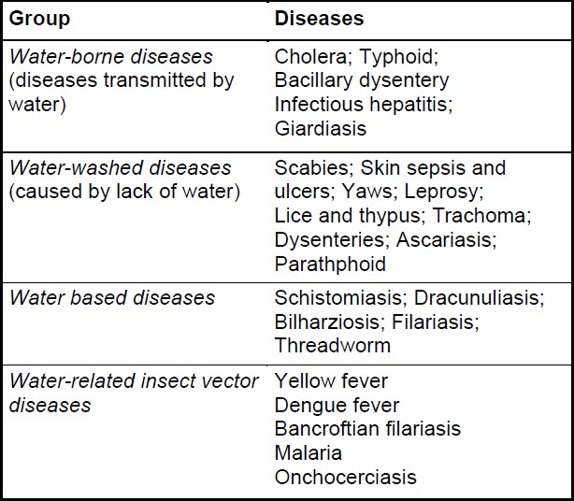
Types of water-related diseases
4 different groups
Water-borne diseases most relevant to WASH interventions
Causing diarrhea, which causes dehydration and malnutrition!
Source: World Health Organization

Slide 34
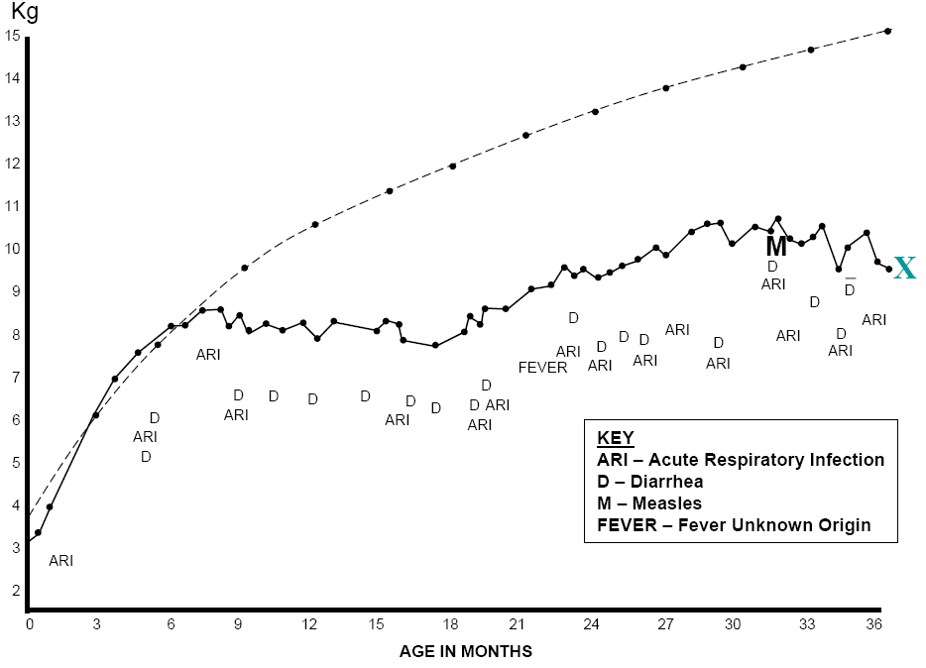
Impacts on child development
Barriers to disrupt transmission of disease
Laxmi‘s short life
Healthy child
Laxmi
Laxmi’s short life.
Source: Dooley, UNICEF Presentation, 2008
Notes:
The graph illustrates the age-dependent development of the weight of a healthy child (dashed line) and of Laxmi – a child from a developing country (solid line). It demonstrates the accumulative burden of disease.
Figure: Laxmi’s short life. (Dooley, UNICEF Presentation, 2008)
Next slide:
What can increase the risk for diseases?
Additional information and questions:
It was not only one severe illness that caused Laxmi’s early death at the age of only three. During her entire life she had to fight one disease after another, among them acute respiratory infection, diarrhoea, measles, and fever. Due to her poor nutrition and health condition, she was affected by numerous infections that led to her early demise.
During an infection, health will be reduced and the person will become more vulnerable to further infections. What can a person do to break this vicious circle?
The graph of Laxmi’s short life shows a normal weight for the first six months, despite of several diseases. What factors lead then to the break-in? What are the effects of disease frequency?

Slide 35
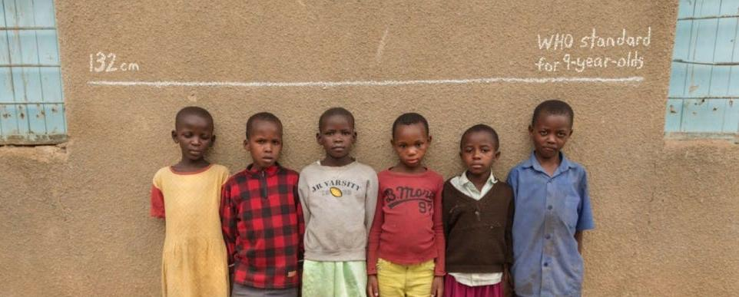
Visible Effect: Stunting
Source: Gates Foundation

Slide 36
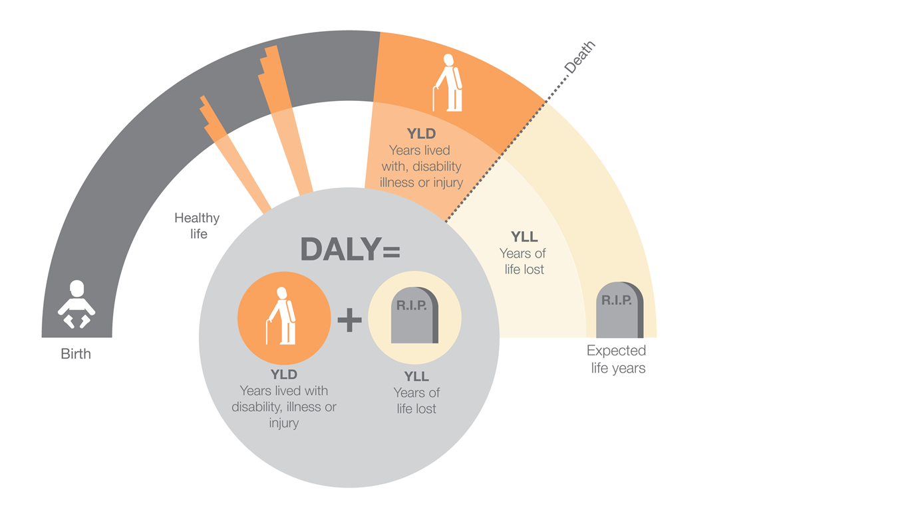
Invisible Effect: Disability Adjusted Life Years
Disability-Adjusted Life Years (DALYs)
the years of life lost as a result of premature death
the years lived with a disease
Source: Public Health England 2015, WHO 2022
Notes:
https://www.who.int/data/gho/indicator-metadata-registry/imr-details/2260
Number of deaths and DALYs
Rationale:
As part of a broader project to assess major risk factors to health, the burden of disease resulting from exposure to unsafe drinking-water, sanitation and hygiene (WASH) was assessed. Access to safely managed drinking water and safely managed sanitation services are Sustainable Development Indicators for Goal 6: Ensure availability and sustainable management of water and sanitation for all. In low-income countries, inadequate water, sanitation and hygiene are important risks to health.
Definition:
The burden of disease attributable to WASH can be expressed as: number of deaths, death rate, number of DALYs, DALY rate. Disability-Adjusted Life Years (DALYs) are a summary measure of population health that combine (i) the years of life lost as a result of premature death and (ii) the years lived with a disease. Death and DALY rates are calculated by dividing the number of deaths, resp. DALYs, by the total population (or indicated if a different population group is used, e.g., children under 5 years). Evidence from epidemiological studies have shown that exposure to unsafe water, sanitation and hygiene habits is, among others, directly linked to diarrhoeal diseases. In this estimate, only the impact of diarrhoeal diseases is taken into account.
Disaggregation:
Age : <5, Sex
M&E Framework:
Impact
Method of estimation:
Burden of disease is calculated by first combining information on the increased (or relative) risk of a disease resulting from exposure, with information on how widespread the exposure is in the population (in this case, the percentage of the population with exposure to unsafe WASH). This allows calculation of the 'population attributable fraction' (PAF), which is the fraction of disease seen in a given population that can be attributed to the exposure, in this case unsafe WASH. Applying this fraction to the total burden of disease (e.g. diarrhoeal diseases expressed as deaths or DALYs), gives the total number of deaths or DALYs that results from inadequate drinking-water, sanitation and hygiene.
Method of estimation of global and regional aggregates:
For deaths and DALYs, national figures are summed. For death and DALY rates, the country deaths, resp. DALYs, are summed according to the region of interest and divided by the corresponding regional population.
https://www.who.int/data/gho/indicator-metadata-registry/imr-details/2260Preferred data sources:
Civil registration with complete coverage and medical certification of cause of death
Special studies

Slide 37

Questions

Slide 38
Stretch Break
washdata.org

Slide 39
Part III
WASH & the SDGs

Slide 40
WASH as a human right
Water, Sanitation & Hygiene (WASH) gained in pertinence:
2000: Millennium Development Goal (MDG) #7 includes a target sustainable access to safe drinking water and basic sanitation.
2010: The UN recognises WASH as basic human right.
2015: Dedicated Sustainable Development Goal (SDG) #6 on clean water and sanitation.
2000 – 2015: MDGs
2020 (10 years)
2015 – 2030: SDGs

Slide 41
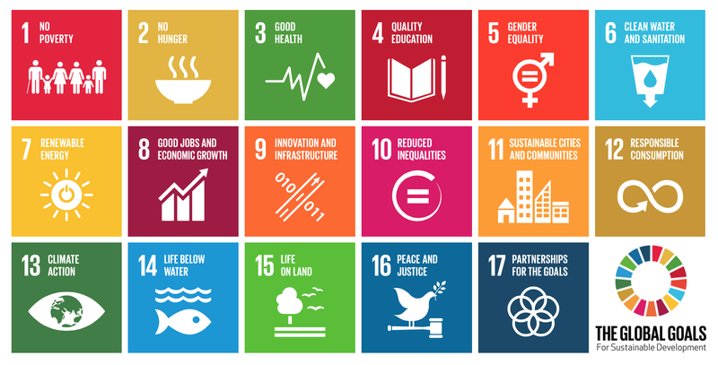
Sustainable Development Goals (SDGs)
17 Goals
169 Targets
232 Global Indicators

Slide 42
Linkages between the Goals
How many goals do you think are linked to WASH?
Notes:
Water linked to all SDGs (SIWI, 2023)

Slide 43
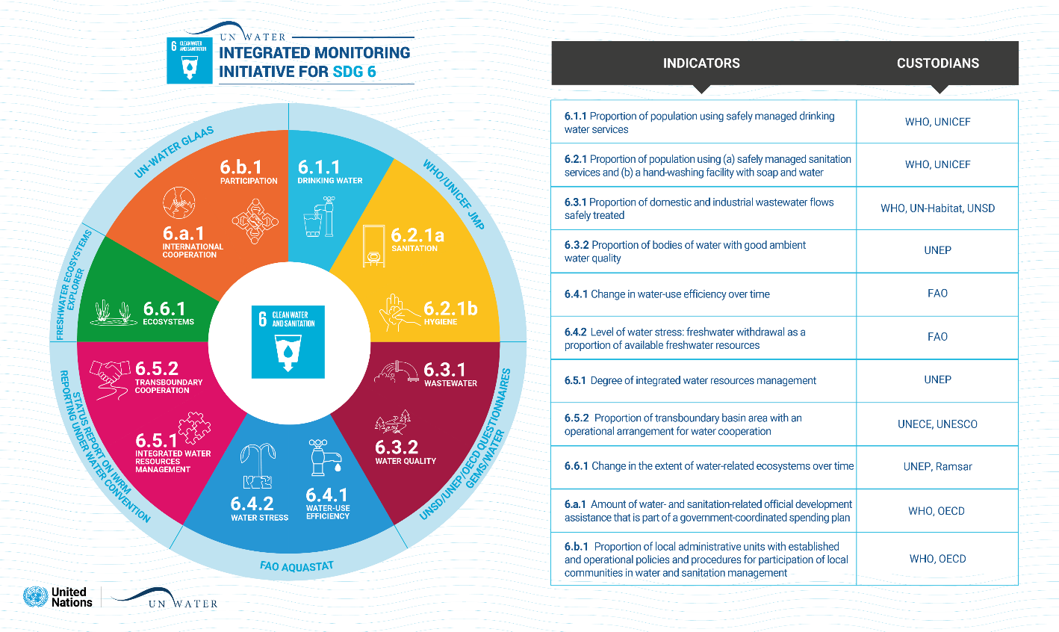
SDG Goal 6
Multiple UN organizations responsible
sdg6data.org

Slide 44
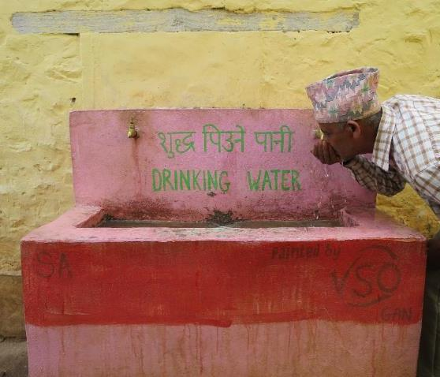
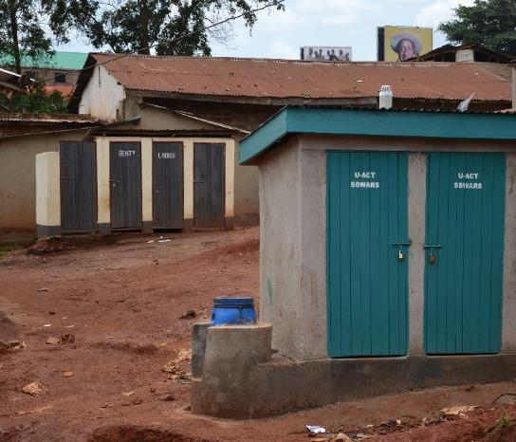
SDGs 6.1 and 6.2
6.1 Safely managed drinking water services
Nepal (Source: Ariane Schertenleib)
6.2 Safely managed sanitation services
Source: U-Act

Slide 45
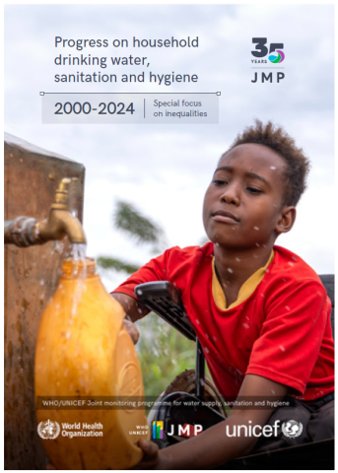
Joint Monitoring Programme (JMP)
UNICEF and WHO are mandated to jointly monitor 6.1 and 6.2.
Data, Monitoring and Reporting
Including special focuses:
    Inequalities
    Health care facilities
    Schools
    Menstruation
    Gender
new!
washdata.org
Source: WHO/UNICEF 2025

Slide 46
Water Service Levels
SAFELY MANAGED | Drinking water from an improved source that is accessible on premises, available when needed and free from faecal and priority chemical contamination
BASIC | Drinking water from an improved source, provided collection time is not more than 30 minutes for a round trip, including queuing
LIMITED | Drinking water from an improved source, for which collection time exceeds 30 minutes for a round trip, including queuing
UNIMPROVED | Drinking water from an unprotected dug well or unprotected spring
SURFACE WATER | Drinking water directly from a river, dam, lake, pond, stream, canal or irrigation canal
Source: WHO/UNICEF 2025

Slide 47
Global and regional drinking water coverage, 2015–2024 (%)
In 2024, three out of four people had safely managed drinking water, but people in least developed countries were more than twice as likely to lack access
Source: WHO/UNICEF 2025

Slide 48
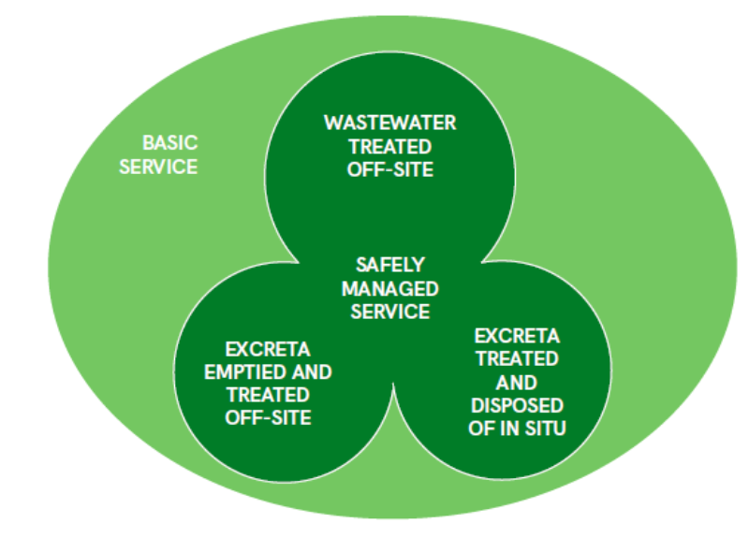
Sanitation Service Levels
SAFELY MANAGED | Use of improved facilities that are not shared with other households and where excreta are safely disposed of in situ or removed and treated off-site
BASIC | Use of improved facilities that are not shared with other households
LIMITED | Use of improved facilities that are shared with other households
UNIMPROVED | Use of pit latrines without a slab or platform, hanging latrines or bucket latrines
OPEN DEFECATION | Disposal of human faeces in fields, forests, bushes, open bodies of water, beaches or other open places, or with solid waste
Source: WHO/UNICEF 2025

Slide 49
Global and regional sanitation coverage, 2015–2024 (%)
In 2024, three out of five people had safely managed sanitation services, but people living in least developed countries were nearly twice as likely to lack access
Source: WHO/UNICEF 2025

Slide 50
Are we on track to meet the SGDs?
Global coverage of WASH services, 2015–2024 (%), and acceleration required to reach universal coverage (>99%) by 2030
3x for basic drinking water
3x for basic sanitation
2x for basic hygiene
Source: WHO/UNICEF 2025

Slide 51
Part IV
Semester Group Work
51

Slide 52
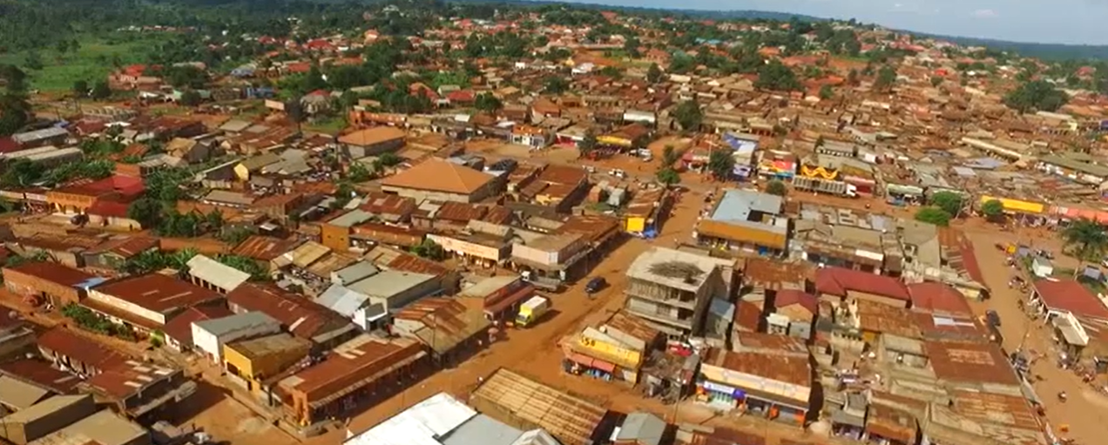
Case Study: Wobulenzi, Uganda
Wobulenzi Town
Source: Mbazila Cylux

Slide 53
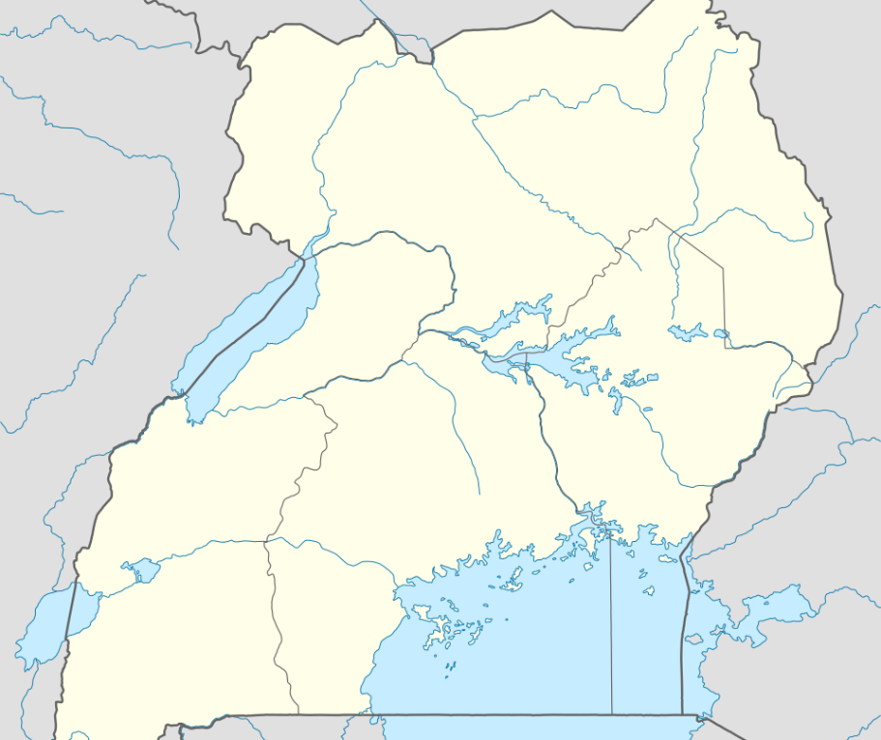
Background
Location: Uganda
➥ Central Region
➥ Luweero District
➥ Katikamu sub-county
➥ Wobulenzi municipality
~31,000 inhabitants
Wobulenzi
Source: NordNordWest/Wikipedia
53

Slide 54
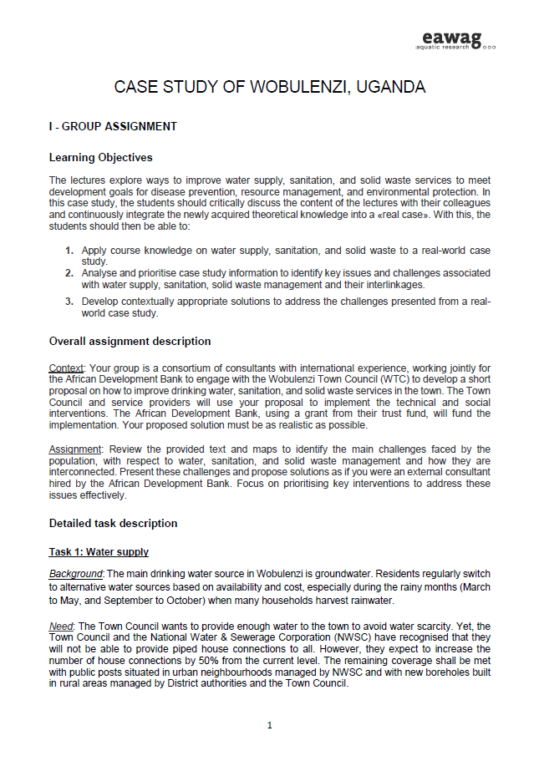
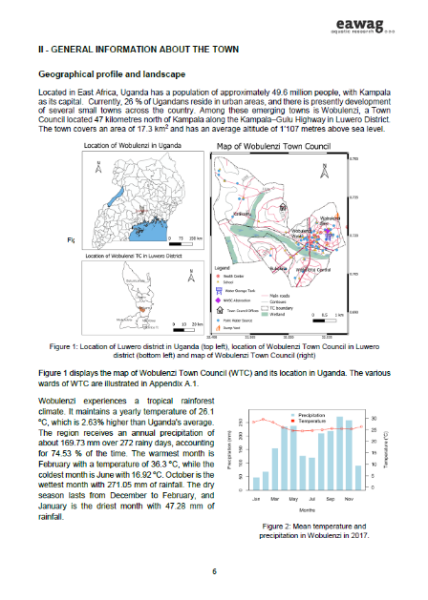
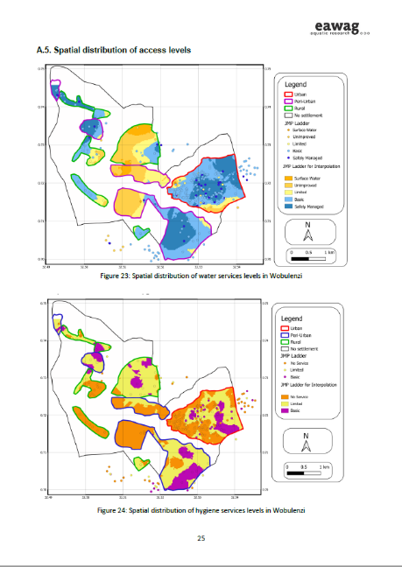
Group assignment: Handout
Handout contains:
General assignment overview
Background info on Wobulenzi
Sectorial analysis:
    Water supply
    Sanitation
    Solid waste management
    Interlinkages
Appendix
    Maps
    Flow diagrams

Slide 55
Group Work Tasks
Develop a decentralized water access and distribution approach (treatment & sales) for the project area
Design a small-scale sanitation solution for the project area
Develop a business and operational plan for a small enterprise to manage solid waste in this community
Critically reflect on the limitations of the proposed solutions in task 1-3 and discuss the possibility of combining some solutions into an integrated system
55

Slide 56
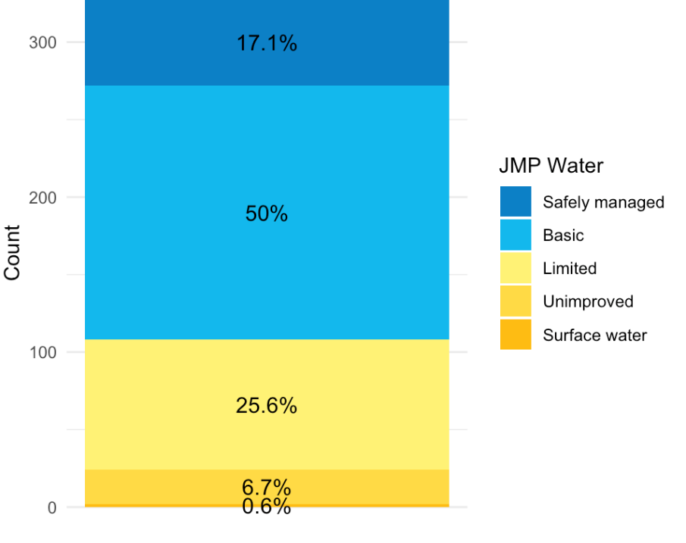
Water Supply: Background
Water Service Access
  Piped water: 44.2%
  Yard connections: 22.6%
  PSPs: 21.6%
Half of households have basic service
Regular supply interruptions
Inadequate chlorine dosing → E. coli contamination
Dirty storage containers → Recontamination!
Water Supply in Wobulenzi (JMP Ladder)

Slide 57
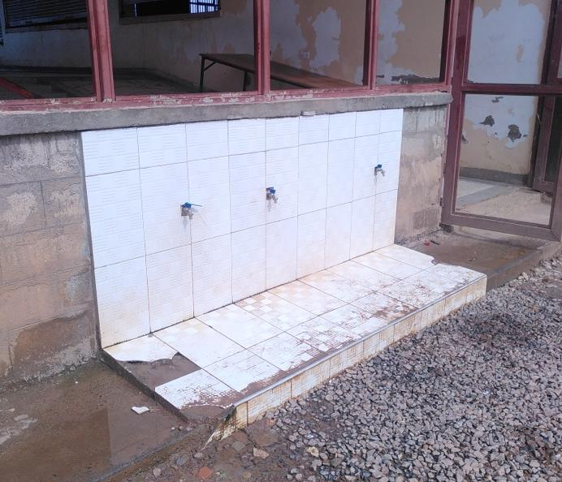
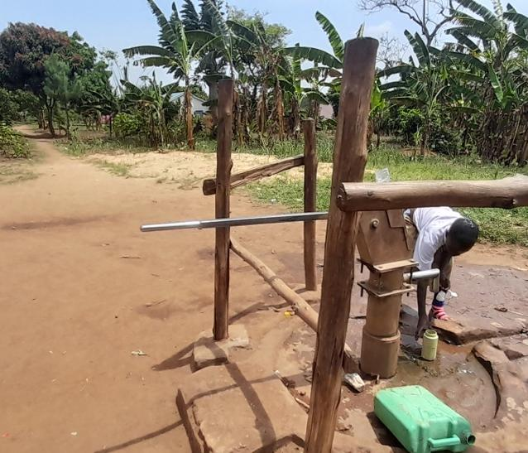
Water Supply: Context
Public Stand Pipes (PSPs) with taps
Source: Sandec
Water from borehole with a pump
Source: Sandec

Slide 58
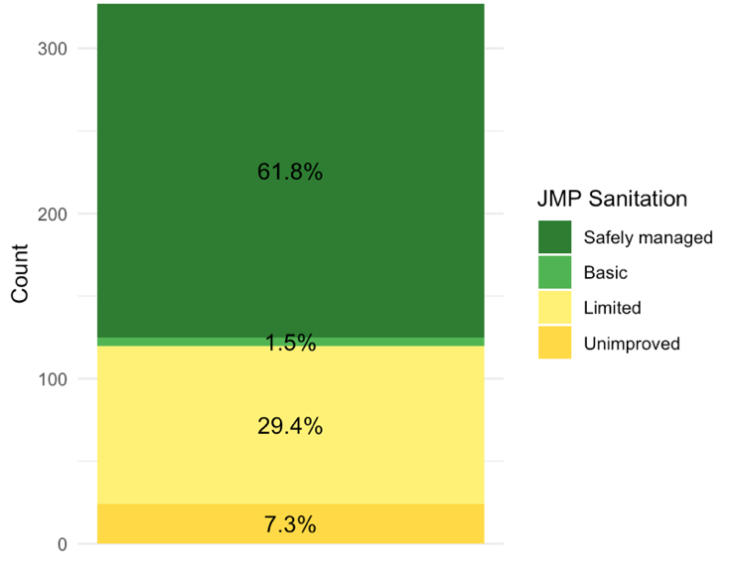
Sanitation: Background
Sanitation Facilities
  Simple pit latrines
  Most are unlined (only 22% are fully lined)
Limited emptying services: only 3% emptied
Underutilized Faecal Sludge Treatment Plant (FSTP)
Sanitation in Wobulenzi (JMP Ladder)
58

Slide 59
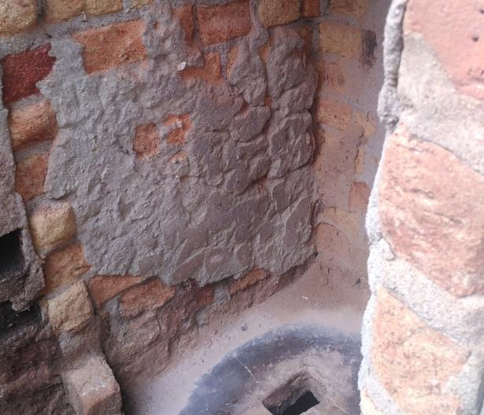
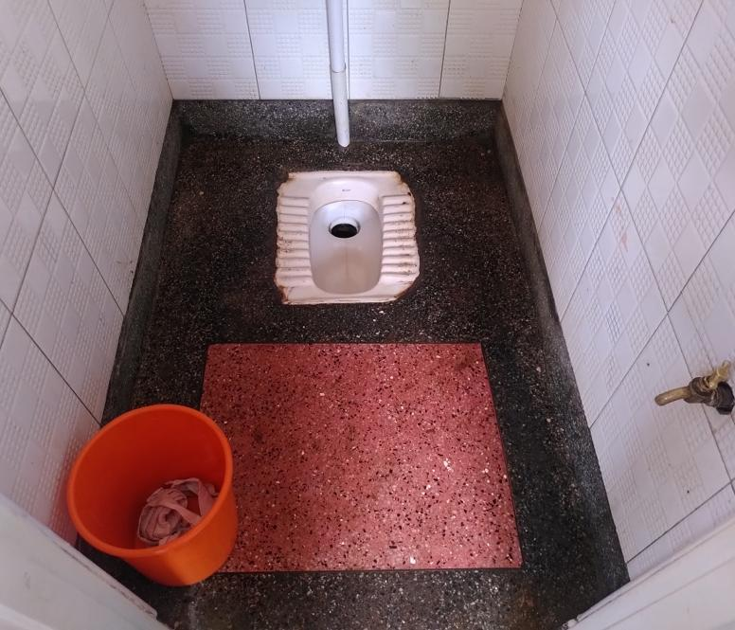
Sanitation: Context
Simple pit latrine
Source: Sandec
Very clean pour flush toilet
Source: Sandec

Slide 60
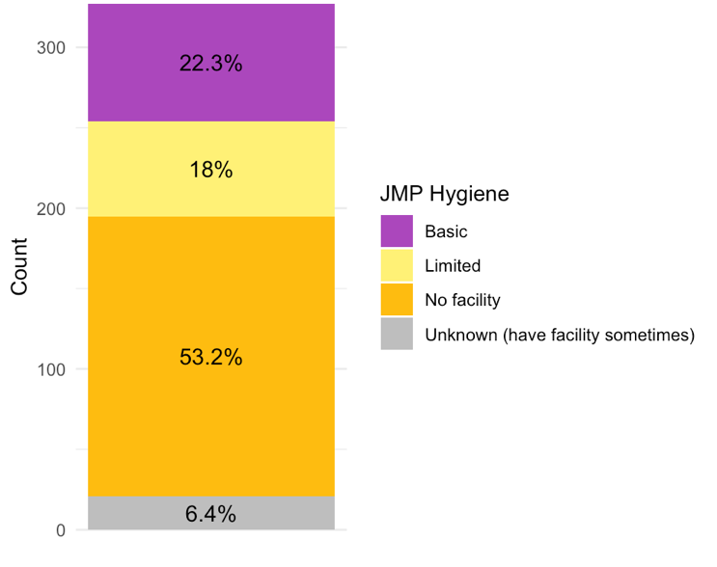
Hygiene: Background
Handwashing Facilities
  Lacking for 53% of households
  Mostly functional where available
Handwashing in Wobulenzi (JMP Ladder)
60

Slide 61
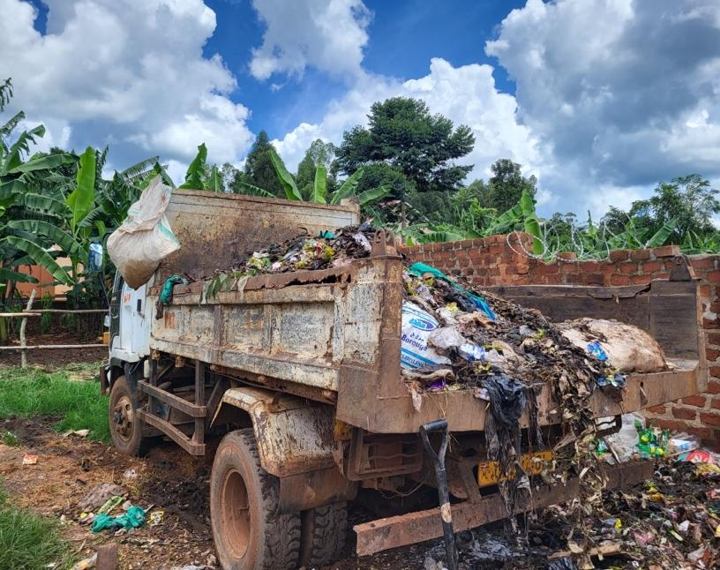
Solid Waste Management: Background
Relies on informal and formal waste collection
Waste disposed in uncontrolled dumpsites: Open dumping & burning
Collection workers face irregular payment
Collection trucks in poor condition
Waste collection truck
Source: Sandec
61

Slide 62
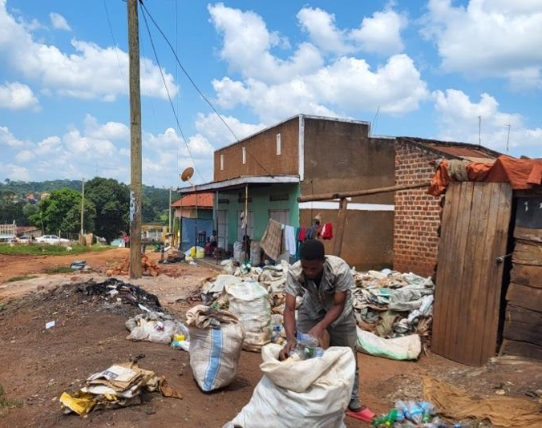
Solid Waste Management: Context
High segregation of kitchen waste, recyclables, and garden waste
Informal junk buyers purchase recyclable items from households
PET is the most separated recycled material by households
Informal PET collection
Source: Sandec
62

Slide 63
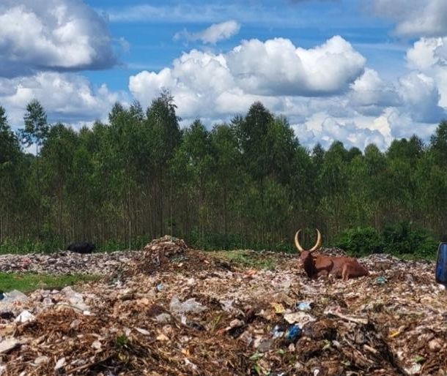
Negative Interlinkages
Disposal of solid waste into pits, water bodies, or stormwater drains
Animal interaction with sanitation facilities and water storage
Drinking water contamination by:
  Leaks from sanitation containers
  Poor hygiene practices
Landfill leachate: Nearby water source contamination
Animal grazing in a landfill
Source: Sandec
63

Slide 64

Positive Interlinkages
Greywater reuse for:
  cleaning
  toilet flushing
  garden irrigation
  animal feeding
On-site composting for:
  nutrient recovery
  recycling of materials from the solid waste stream
Agriculture site
Source: Sandec

Slide 65
Expected outputs, grading & next steps
Final grade:
  Exam 70%
  Group work 30%
Group Work Tasks
Form groups of 5 students
One group member communicates members + student ID# to Christoph Lüthi by email
Each week your group meets to discuss and work on proposal
Hand in final report by 18th December 2025 as pdf file by email
1 report (max. 13 pages, Arial 10, single lined).
Christoph.Luethi@eawag.ch
65

Slide 66
Group Work: Learning Goals
Apply course knowledge on water supply, sanitation, and solid waste to a real-world case study.
Analyse and prioritise case study information to identify key issues and challenges associated with water supply, sanitation, solid waste management and their interlinkages.
Develop contextually appropriate solutions to address the challenges presented from a real-world case study.
66

Slide 67







Key resources (Part 1 of 2)
Guidelins for drinking-water quality: Small water supplies (2024)
67
Notes:
Why shit matters > TEDx talk
Sanitation Compendium (2014)
Biowaste Management: the key to sustainable municipal solid waste management (2017)
Progress on household drinking water, sanitation and hygiene (2025)
Global Report on Sanitation & Wastewater Management (2023)
Faecal Sludge Management (2014)
Guidelines for drinking-water quality: Small water supplies (2024)

Slide 68




Key resources (Part 2 of 2)
emergency-wash.org

Slide 69
Questions

Slide 70
jessica.macarthur@eawag.ch
Herzlichen Dank !
Thank you!

